Slide 1




Doing Data Science Right
in Excel-Pervasive Utilities
Eina Ooka
September 25, 2018

Slide 2

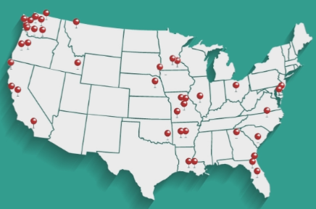
The Energy Authority (TEA)
The Energy Authority serves public utilities nationwide for trading and analytics.
Analytics team provides forecasting and analysis including:
Load and market forecasts
Portfolio risk and hedge analysis
Congestion and transmission analysis
IRP studies and many more…
A few dozen analysts in the team
Notes:
I work for the Energy Authority that serves public utilities nationwide for trading and analytics.
Analytics team provides various forecasting and analysis services including load and power price forecasting, …, and there are a few dozen analysts in the team.

Slide 3
TEA Analytics ~ a few years ago ~
Excel clutter
Accumulation of errors over time. Hard to detect them in enormous multi-tab models.
Duplicates of a same model for different versions (e.g., for different customers). When making changes, same changes needs to be made multiple times.
No version controls. Accumulation of badly named similar excel files and many no-longer used scripts and calculations.
For large dataset, it was slow.
Multiple languages were used in addition to excel
VBA, R, matlab, python, …
No clear guideline for analytics quality control
Notes:
With widespread use of excel spreadsheets, we had issues as you all are probably familiar with.
First, there is a limit to the amount of data Excel can handle. Even if that’s not an issue, IF we use a same excel model over time, errors somehow get in and accumulate. Those errors are hard to detect in large multi-tab workbook with links everywhere. Version control is almost impossible with excel models and sometimes we end up with copies of seemingly same models.
Outside of Excel, we had analysts using different scripting languages, and there were no clear guideline for analytics quality control.

Slide 4
My Goals
Build out a data science platform that enables:
Analytics Quality Control
Efficient and rapid development of a solution into delivery
Encourage collaboration
Terminology
A platform is the environment on which computer programs can run. For development process, it can be a constraint or an assistance.
A computer program is written in a programming (or scripting) language. In our case, it is a model and an analysis written in scripting languages.
Notes:
So over past few years, I was set to improve the situation, and my goal was to build out a data science platform that enables…
Here I’m using a word “platform” and let’s clarify what I mean. Platform is an environment on which a program can run. Depending on the functionality of a platform, it can be a constraint or an assistance in doing tasks. Also, a computer program that runs on platforms are usually written in programming or scripting languages, and in our case, it is a model or an analysis written in scripting languages.
In my presentation today, I’m assuming that most of you here have some familiarity in scripting, and that data science to be conducted using it. Even if you are not so familiar with scripting, I hope this presentation will help you understand the benefit of using scripting languages.

Slide 5
What’s Needed in Data Science Process?
Notes:
So let’s talk about data science process.

Slide 6

Data Science (Analytics) Lifecycle
Define Objective
Get Data
Modeling
Evaluation
Delivery
Frequency
One-time study
recurrent
Format
csv
Excel
Power point
Documents
Reports
Interactive (I/O)
User Interface
API
Notes:
This is a data science life cycle, and it shows steps in doing data science project.
We start a project by defining the objective, get data, do initial analysis, repeat modeling and evaluation multiple times, until we get satisfactory results, and then we deliver it.
In utility world, this delivery can take different forms. Projects are sometimes one-time studies or can be a recurrent task. Deliverable can be a written up report or data files, or sometimes we need to deliver a model itself that lets others run with inputs.

Slide 7
Data Science Platforms
Define Objective
Get Data
Modeling
Evaluation
Delivery
Deployment Platform
Data Platform
Frequency
One-time study
recurrent
Format
csv
Excel
Power point
Documents
Reports
Interactive (I/O)
User Interface
API
Modeling Platform
Notes:
In any cases, we need some modeling platform for the modeling, we need data platform for storing the data, and deployment platform for delivering it.

Slide 8
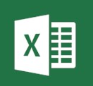
Excel - Jack of All Trades
Deployment Platform
Interface
Reports
Data Storage
Data Platform
Modeling
Modeling platform
Notes:
And thinking it this way makes it clear why Excel is so useful – it can store data, we can build models in it, and we can use it as the deliverable.
In this way, Excel is like a jack of all trades, and it is useful when we are doing a relatively simple task. But once we step out to a more complicated analysis or modeling, we start realizing that it’s a master of none. And that’s why our team decided to examine other platforms.

Slide 9
Data Science Platforms
Task Scheduler
Deployment RShiny
Data
SQL Server
Modeling
R
Version Control
GitHub
Notes:
At the end we chose R, Rshiny and SQL Server as our platforms. We’ll discuss these choices in details later, but here, let’s also realize that we actually need other supporting tools to make the entire data science process work. We also need Version Control and task scheduler.
But unlike Excel, we have separate bubbles here.

Slide 10
Data Science Platforms
Task Scheduler
Deployment RShiny
Data
SQL Server
IDE
RStudio
Modeling
R
Version Control
GitHub
Packages
Notes:
And that’s where IDE, or Integrated development Environment, and different packages come in.

Slide 11
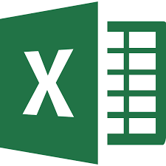

Excel or non-Excel?
Use Excel if
Summary data
Model- and data-light
Share with others
A quick task where a jack-all-trades is all you need.
Do Not Use Excel if
Needs scripts
Model-heavy
Data-heavy
Recurring Task
Need a team of masters
Notes:
Before we move on, let’s summarize. When should we and should we not use Excel?
My answer is; use Excel when it mostly stores summary data. Particularly when the entire project need to shared and understood by other non-technical people. When the project is model- and data-light, sure, Excel is a great tool.
However, if it is model- or data- heavy, and that scripting makes it easier to do the task, or if it is a recurrent task, we can do better than using Excel. .

Slide 12
Analytics Quality Control
Notes:
But then what is better? Well, let’s talk about analytics quality control.

Slide 13
Aspirations for Model Design
Accurate
Robust
Do outliers affect the results too much?
Parsimonious
Is the model overly complicated?
Explainable
Simple understandable model is better than black box. (Note: LIME)
Consistency
Is the behavior consistent over time? Backcast.
Notes:
I have various aspirations when I build models.
First thing first, the results need to be accurate. But that’s not the only thing we want to achieve.
We want to achieve robustness where effects from outliers are managed.
We want parsimonious solution, that is, the simplest model possible without scarifying any of the accuracy.
We want an explainable model, and this is super important. When there is a hype on sophisticated machine learning models, we get attracted to using them including myself. But simple understandable model is often more useful. By the way, it’s a bit of a side note, but a new r package called LIME came out not too long ago. LIME is an acronym for “Local Interpretable Model-Agnostic Explanations”. It gives explanations to even black box models. When model doesn’t give explanation on its own, it’s still important to explain the model behavior using these types of technics.
The 5th aspiration is consistency. We need to make sure that model doesn’t go hay-wire over time. We usually conduct backcasting for this purpose.

Slide 14
Aspirations for Model Design
Adaptable
Can we use parts of the model on other projects?
Scalable
Can we scale up the project to includes many other nodes, customers, etc…?
Accessible
Can other people understand and run the model?
Reproducible
Can we produce the same results later?
Notes:
Aspiration 6. We want the model to be adaptable. If there are any parts of the model that can be generalized and re-used for other analysis and models later, we should, and we should design models that way.
7. Scalable. Whenever we design a model, we should keep in mind how to add a few dozen nodes or customers, etc…
8. Accessibility. Can other analysts understand and run the model?
And lastly Reproducibility. It’s important to make sure that we can always go back and reproduce results.

Slide 15

Common Language
Efficiency gain
Collaborations between analysts
Maintenance of a model over time
Re-use and share codes
Protect against loss of work
Others can easily inherit other’s models
Hedge against a sudden leave of an analyst
Notes:
Another important factor for the team is setting a common language. The efficiency gain that comes from analysts being able to share codes is immense. Collaborations are more easily accomplished and maintenance of a model become possibly even when the original modeler is no longer available.

Slide 16
More qualitative than quantitative
Evaluations
Notes:
Now we have aspirations defined. Let’s talk about evaluating what platforms help in achieving those.

Slide 17
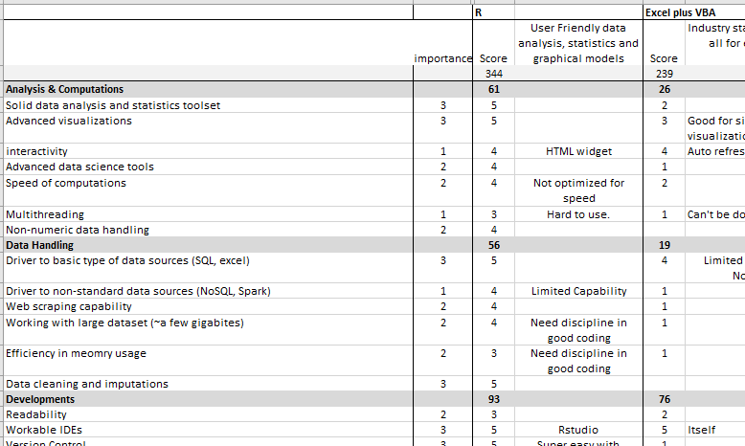


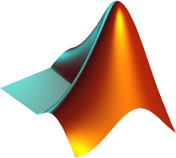


Modeling Platform
We evaluated several scripting languages.
Quantification by scoring was helpful but not the determining factor. For us, decision was more subjective.
Our choice was R.
Notes:
We evaluated several scripting languages including matlab, VBA, R and Python.
Before conducting the actual evaluation, I thought that quantifying the usefulness of tools into scores would tell us the ultimate answer. We identified important characteristics, gave them importance, and scored them. This screenshot was a part of that attempt. Unfortunately, it ended up that the decision was a more subjective matter. In our cases, it came down to one question; which language was easier to adopt given the team’s culture.
Ultimately R was a good choice for us. But it doesn’t have to be the ultimate choice depending on your situation. Scoring like this may not give you an ultimate answer, but it was a good exercise.

Slide 18





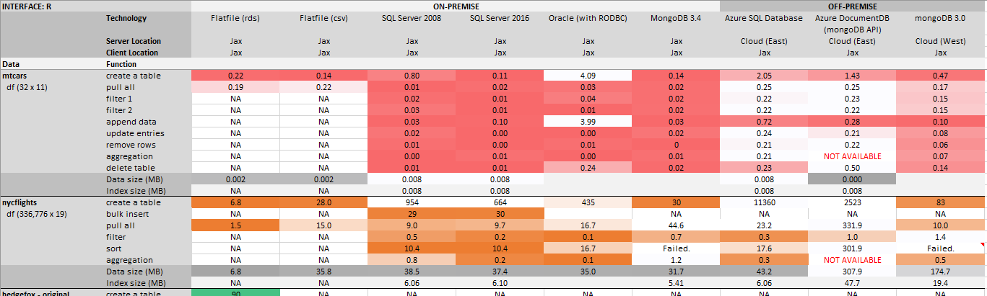
Data Platform Dedicated to Analytics
We evaluated on-premise and on-cloud databases including types of SQL & NoSQL.
How does it perform w.r.t. R?
DBI compliant? Flexibility of NoSQL?
Our choice was SQL Server.
Notes:
I should note here that TEA already had data servers for storing various data. But we needed another server that was dedicated to analytics processes. We evaluated SQL and NoSQL servers on-premise and on cloud environments. All of the evaluation was done through R, since at the end that’s how we were going to interact with the data server.
At the end, the company’s already existing infrastructure was a large reason for sticking with SQL server, but I believe that data platform evaluation is not a closed case, as the nature of data in utility industry keeps changing.

Slide 19




Delivery Format
If we simply deliver flat files or reports, no need for deployment platform.
R-markdown has made R reporting extremely easy and visually appealing.
There are numerous r packages that enable saving results in Excel.
Deployment platform is necessary when a deliverable is a model with inputs/outputs.
Frequency
One-time study
Recurrent
Format
csv
Excel
Power point
Documents
Reports
Interactive (I/O)
User Interface
API
Notes:
Now it’s time for discussing Deployment Platform, but instead let’s talk about Deployment Format first.
I’ve briefly mentioned earlier about different deliverables. If the deliverable is simply reports or data files, we don’t need a deployment platform. R can export various data files directly, and it also has a powerful reporting tool called rmarkdown.
We need a deployment platform because a deliverable is sometimes a model that takes inputs from users and interactively outputs results.

Slide 20


Data Science Deployment
When non-utility data scientists say “deployment,” they usually mean:
The model is turned over to software developers to translate into a production language.
→ We don’t have software developers to spare…
Deploy models on their own as APIs.
→ We don’t have web developers to spare…
How do we create a user interface for
our models without going back to Excel
or relying on IT developers?
They mean
We need
Notes:
And here is the problem. When a non-utility data scientist says “deployment,” they usually mean one of 2 things: …
Unfortunately, 1 is not an option because we just don’t have spare software developers to do that for us.
And 2 isn’t an option either by itself, since we don’t have an analytics-dedicated web developer that can create a user interface that utilizes APIs for us.
Then how do we create a user interface for our models without reverting back to Excel or relying on IT developers? This was my question when I searched around for deployment platform for our team.

Slide 21
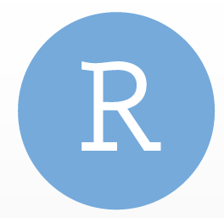




Deployment Platform
We evaluated
Various “Data Science Platforms.”
There were a lot fewer numbers to evaluate in 2015.
MS Azure
They were starting to push Azure ML and other services.
Various BI tools
R Shiny Server
We chose R Shiny Server.
Shiny (r package): HTML wrapper and generate apps on a desktop.
Shiny Server: web service for hosting shiny apps.
Notes:
We evaluated various products marketed as “data science platforms.” This was year 2015 which is only 3 years ago, but there were a lot fewer products then. Regardless, the problem was that what they meant “deployment” in non-utility data scientists’ sense. None of them gave us comprehensive user interface.
We also evaluated BI tools and Azure. BI tools focused on creating an interface that we needed, and MS Azure gave us something between so-called data science platforms and BI tools.
But none of them came close to R Shiny Server in our evaluation, given that we had already chosen R.
For those of you who are not familiar with R Shiny, let me explain it a little. An R package ‘shiny’ generates HTML wrapper around R to generate web-based graphical interface on desktops. R Shiny server hosts those shiny apps on the web so that it can be accessible from anywhere on the web. The first version of Shiny Server had become available in 2014, and this evaluation was 2015. We decided to go with this brand new technology, and it’s lucky of us that r shiny took off since then, becoming even more powerful over last 3 years.

Slide 22

Deployment Platform Evaluation Criteria
Vision
User Interface
Web-based or installed app?
Visualization capability and its flexibility? Can we show r plots?
Can we modify inputs and re-run the model from the interface?
Download data or reports from dashboard.
Interactive plots
display on mobile devices
Ease of deployment
How much IT help do we need at the time of deployment?
Data
Can it connect to TEA’s internal databases?
Is there a limit to the size of data it can handle?
Accessibility
Authentication? Differentiation in authentication levels?
Is the dashboard accessible from internal and external users?
How many people can access the application concurrently?
Scalability
How scalable? If so, does the price reflect it?
Languages
R
Python
API & Web Services
Can we call models from BI?
Other functions
Scheduled runs?
Version Control?
Collaboration?
Technical Support
Is technical support available?
Are there online resources?
How responsive are they?
Notes:
When we evaluated the deployment platform, we listed out detailed evaluation criteria. This is more like a vision statement. Sometimes, seeing what’s available in various products can lead the evaluation process too, but I recommend knowing what you want at the end.

Slide 23




Data Science Platforms
Task Scheduler
Deployment RShiny
Data
SQL Server
IDE
RStudio
Modeling
R
Version Control
GitHub
Notes:
So we had 3 large components of the data science platform. Now let’s talk about other supporting tool.

Slide 24
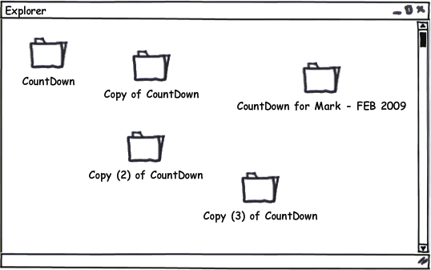
Source Control
Git for
Source Control
GitHub for
Managing Repositories
Project Management
Collaboration
Issue tracker
Use of Git, together with Shiny was a game changer for us.
Eliminated accumulation of similarly named files or commented-out old scripts.
Easy differentiation between multiple (Dev, PROD, …) environments.
Notes:
Tools for source control is very important. We’ve all had experiences encountering numerous similar files with edit dates, person’s initials, or version numbers, and just copies of copies of copies. It’s extremely hard to tell what’s been changed in the file, by who, and which files follow which one when multiple people are involved. Not only that, but without proper source control, people comment out sections of obsolete codes instead of deleting them, so that junk accumulates in the file over time. This is actually one of the worst thing about Excel.
I have to confess that analysts are not trained as IT engineers, and bringing in a discipline like source control doesn’t fly so easily. However, using GitHub was a game changer for me personally, and I highly recommend to anybody who uses scripting languages.

Slide 25
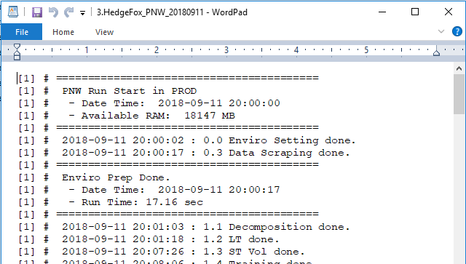
Other Supporting Tools
RStudio IDE (Integrated Development Environment)
In recent years, it has integrated many features necessary for efficient data science work.
Task Scheduler with Batch Tasks
You can add arguments
Don’t forget to output a run log.
Setting up Dev, Staging and PROD environments.
Set naming conventions and coding practice guidelines.
Data Camp for new users within the group.
Notes:
Another important supporting tool is IDE. Rstudio is the most popular choice for R coders, and the IDE makes other tools and packages accessible for efficient development.
Another task that I use regularly is a task scheduler. I use microsoft task scheduler for tasks that can run on one machine, but if you need to distribute tasks over multiple machines, you may want to investigate other tools out there.
And here is a little modeling tip for you; when you try to run r scripts as scheduled tasks, I also highly recommend getting into a habit of generating meaningful run-logs for each model run. I have a screenshot of a run log here, and it tells us when what step completed running. So if the model run fails, I can tell where it failed.
Let’s see, other recommendations are setting up and differentiating dev, staging and production environments in order to ensure stable production model.

Slide 26
AURORA Modeling - Previous Cut&paste Method - Current One-Click reporting method
Case Study 1
Notes:
Let’s look at case studies. TEA runs AURORA which is a cost-production model. I’d like to show you how my old cut&paste method changed into a one-click reporting method.

Slide 27
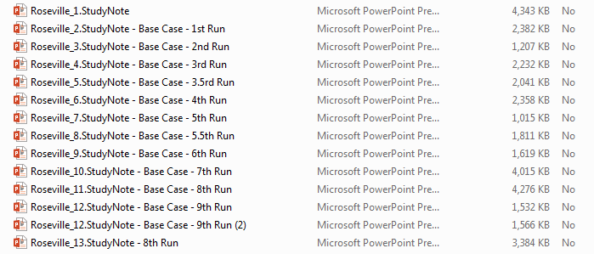
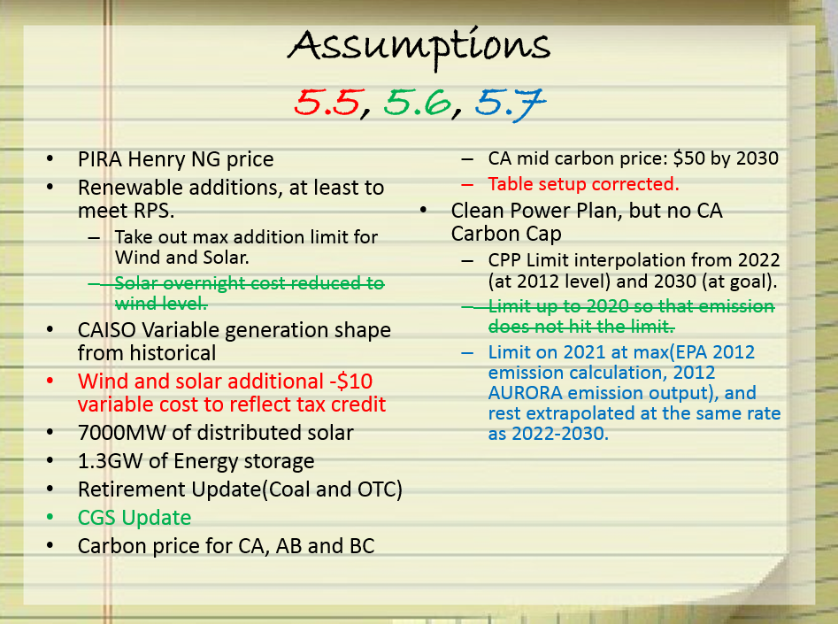
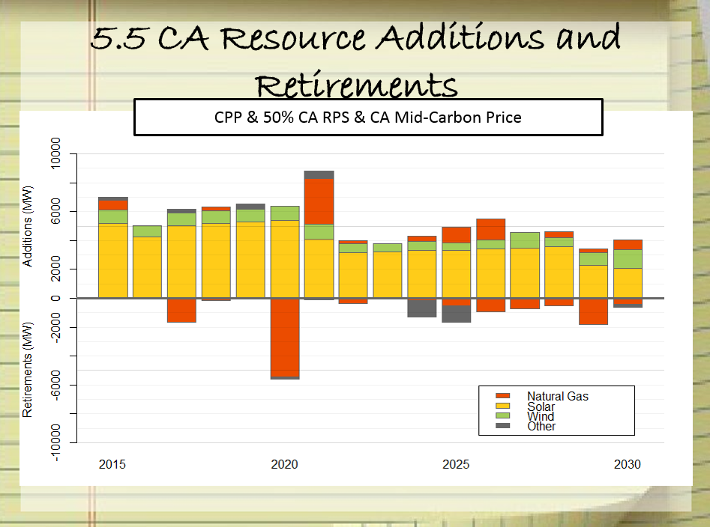
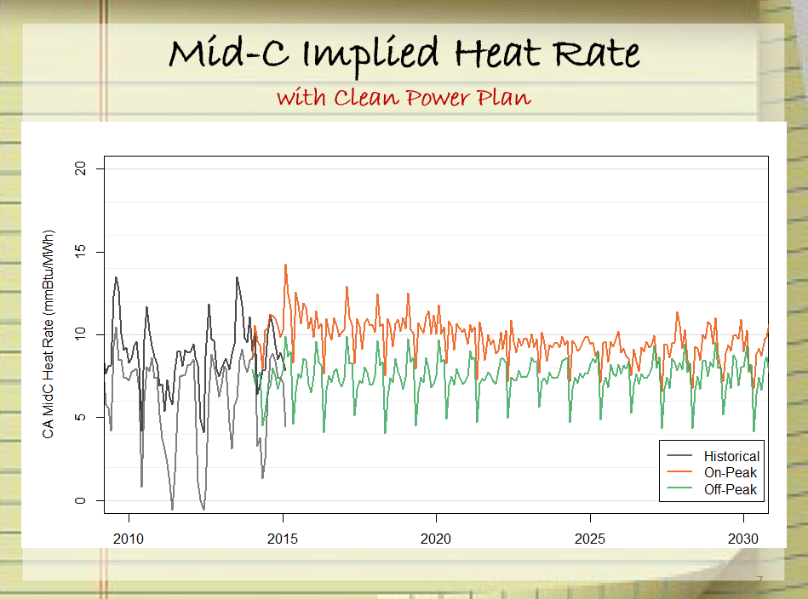
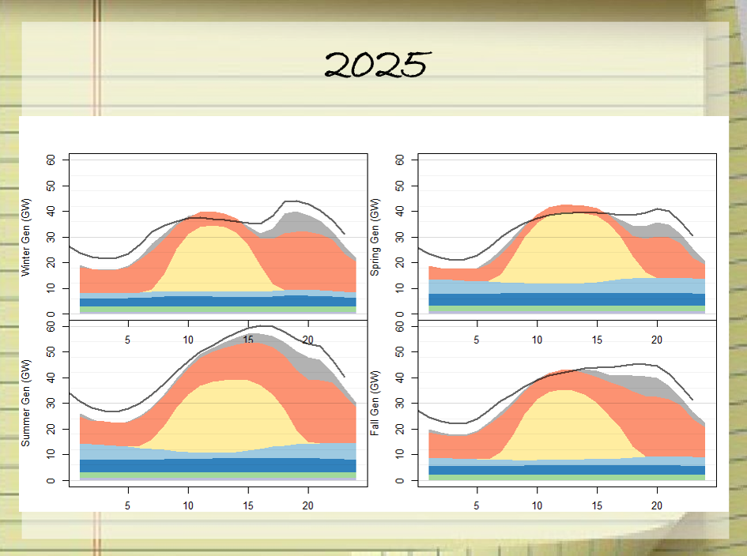
Before… AURORA Reporting Task
…
Notes:
Before the current process, I used to repeat a process of tweaking inputs, running a model, and producing bunch of plots before generating the final outputs. In each iteration, I organized results by copying and pasting plots into a sequence of power points.

Slide 28
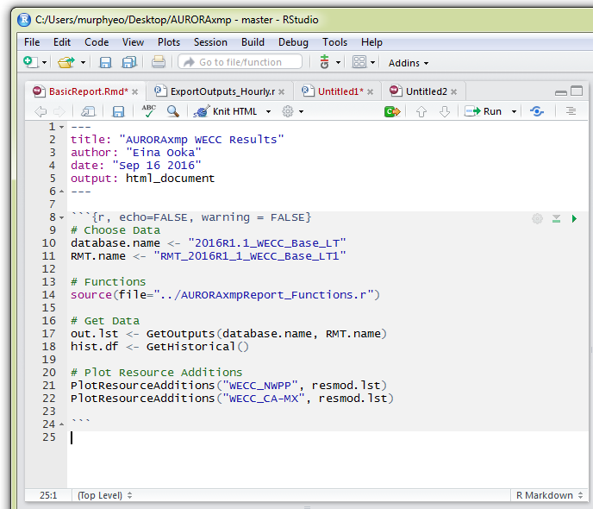
Current Reporting Process AURORA Reporting Task
Run the cost-production model and export all outputs into a database.
Open R. Update the database names and “knit.”
Done.
Notes:
The old process was improved by using R reporting tool called rmarkdown. Now when we run a model, we push all data into a database, open R, update the database name and one-click on “Knit HTML.”

Slide 29
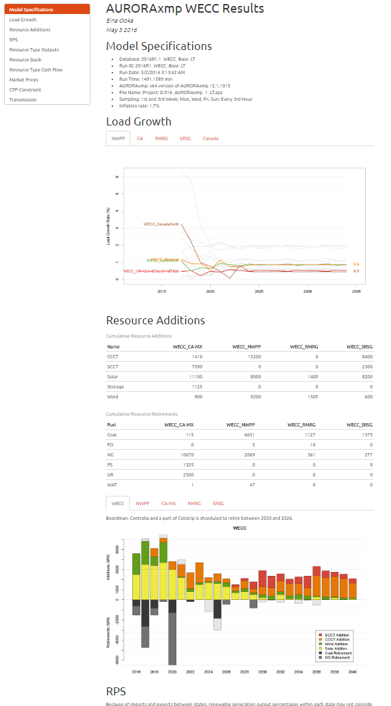
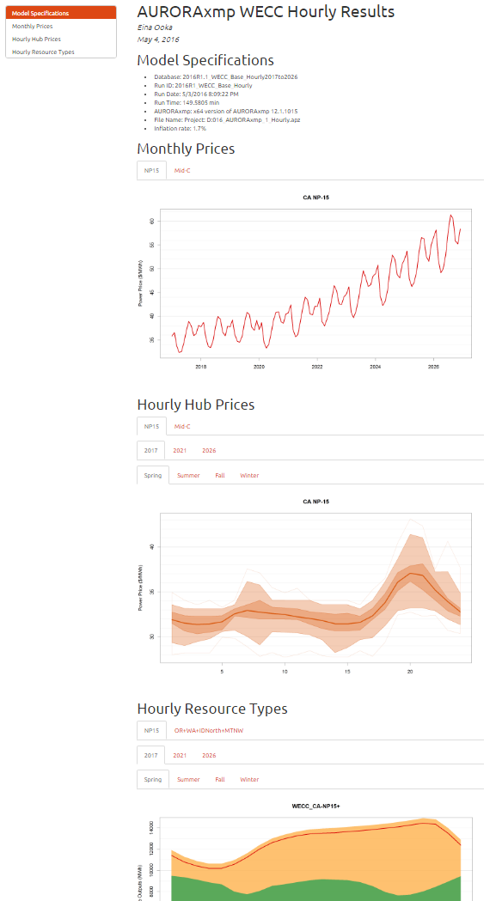
Notes:
By doing so, what we get is a report that includes all necessary plots and run information.

Slide 30
Portfolio Risk Model - Previous Excel & VBA Frustration - Current All-R Discipline
Case Study 2
Notes:
Let’s look at another case study. My personal specialization is stochastic market modeling and I have worked on translating excel & VBA model into an r model.

Slide 31
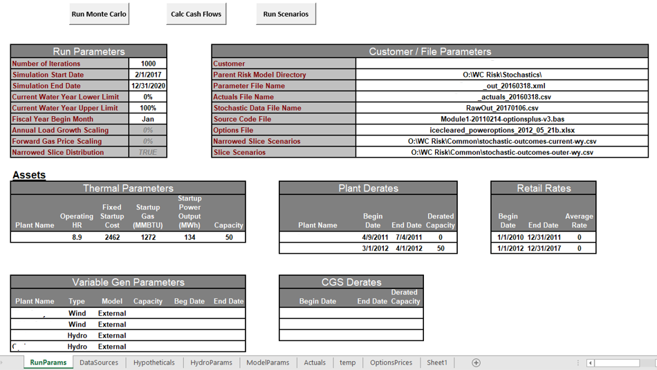
Portfolio Risk Model Before…
There were Stochastic Portfolio Model written in VBA with Excel Interface.
Produced large excel and csv files.
We had copied of similar models with some customizations, for each customer.
We saved copies of old models in Archive folder.
Notes:
When I came to TEA, we were using a portfolio risk model that had an excel interface as you see here, that had a relatively complex monte carlo engine behind it, all written in VBA. It produced large csv files and without version controls, we had multiple similar models for different customers.

Slide 32
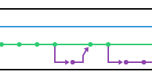
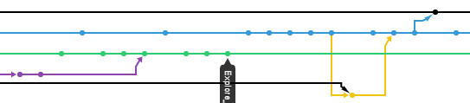
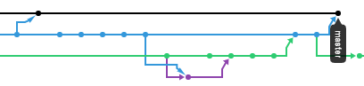
Current Model
Everything is in R.
The bulk of the model runs automatically overnight as a scheduled task.
Shiny UI enables on-demand analysis on the results.
Differentiation between Dev, Staging, PROD environments.
GitHub Project Network View
Notes:
I translated all into R. The bulk of the model runs overnight as a scheduled task, and a shiny UI enables on-demand hedge analysis. The differentiation between production and development environment ensured stable and always available production models.

Slide 33
Demo: Shiny App
Notes:
Let’s actually take a look at how the app looks like.
First of all, this is accessible via regular web browser with no installation of any sort. It asks us to log in. And here we are, in the app.
Now I’m loading in 5 years worth of daily data for 1000 iterations for 50 variables. That’s over 100 million data points that we just imported. In excel, imagine how long it’ll take to do anything with that much data.
Another thing we can do is defining a hedge scenario, running them and seeing the results immediately. We can interactively analyze data and we can directly download data from the app.

Slide 34
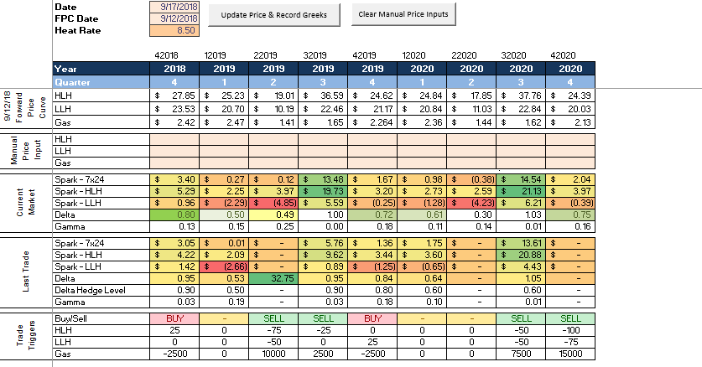
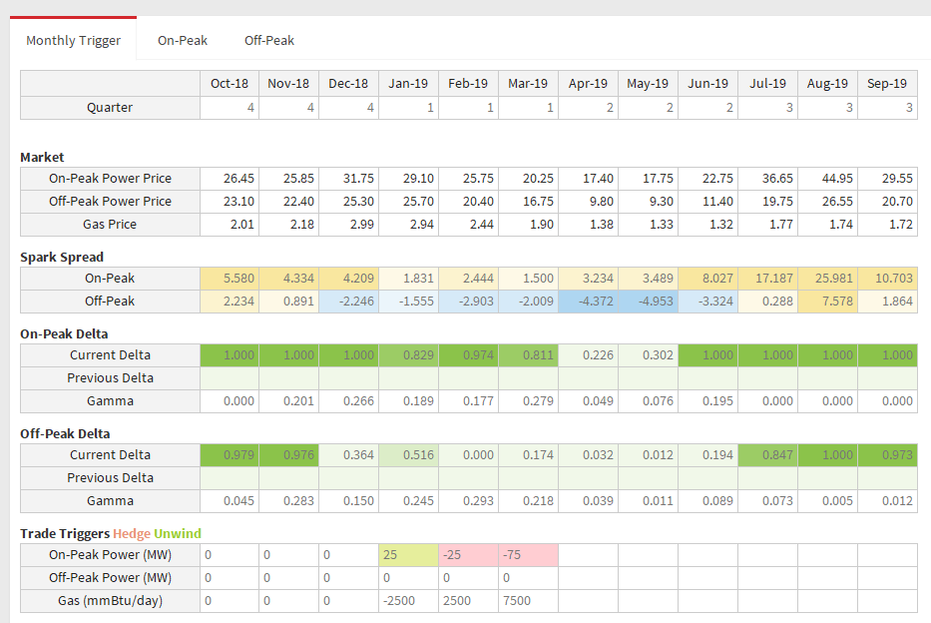
Looks “Good” by Default
Shiny templates are easy to use.
No knowledge in HTML or JavaScript necessary
Excel-looking interface possible by creating input tables and color-formatted data.
Excel Interface
Shiny Interface
Notes:
There is a large benefit in creating this shiny interface, but the best part is probably the fact that we can build these apps without knowing anything about HTML or web design, and still looks good. We can even make it look more like Excel by providing formatted or input tables.

Slide 35
What does it look like in reality?
My Desktop & Workflow
Notes:
So you’ve now seen the final products and you know what tools I use to make them. Now I’d like to show you my desktop and share the workflow.

Slide 36
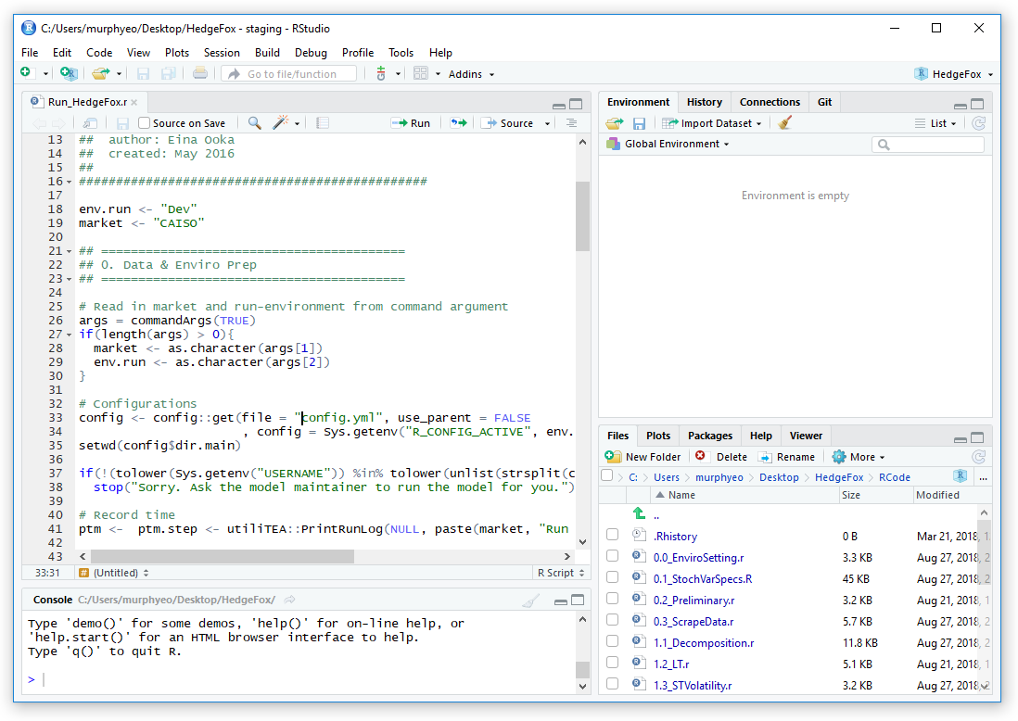
Notes:
I always have Rstudio open that looks like this. On the left, I have the scripting window, and I have console where the computation is done. On the right, I have various supporting tools available.
All of my scripts are saved as a part of a project folder. All scripts start with a purpose and basic information of the model, and an environment specification. Depending on the environment specification, config scripts sets the actual environments.
When I design the model to run as a scheduled task, it usually have this block of code that reads in arguments from batch tasks, and functions that writes out messages in run-logs.
Git and GitHub are also accessible from Rstudio.

Slide 37
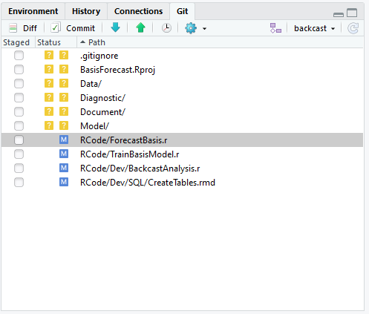
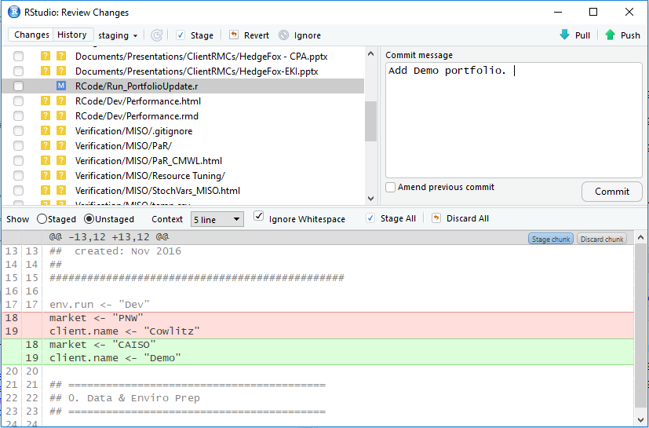
Notes:
This project is synched up with repository in GitHub, and I can commit changes from here. Having this functionality within Rstudio makes source control easy to manage.

Slide 38
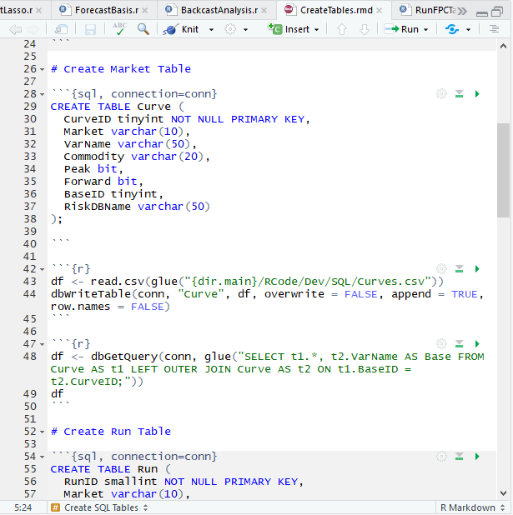
Notes:
There are also functionalities for r-markdown that I mentioned earlier for generating reports. In addition to reporting capability, Rmarkdown can handle connecting to databases and running different types of scripts within it. This is an example where I have SQL scripts right above R scripts. Both of these blocks can be run from the same environment which is quite convenient.

Slide 39




Config
Dev
env <- Dev
Server
Linux Box
env <- Staging
DB
Batch Task
Staging
Internal access only
env <- PROD
DB
Batch Task
PROD
Scheduled Task
analyze.teainc.org
Notes:
This is the system that I manage now.
I have 3 environments that are all specified by a single config file.
I have dev scripts, staging scripts and PRODuction scripts that are all synched up with branches of github repository. I have database and batch tasks defined for each environment, and scheduled tasks are set for production models. Separately I have staging and production shiny apps that run of Linux.
I have to admit this this is a lot to manage compared to one excel model that contained everything. However, when I look back on the modeling aspirations, this system can achieve them more easily. Also this system is for a recurring production model. Depending on what you’d like to achieve, just adopting a part of this may fit you better.

Slide 40
Take Away
Choosing the right set of platforms can help broaden our capability.
We need multiple platforms that all work seamlessly together.
Graduating from Excel takes a discipline, and not all projects need to move away from Excel. But if you choose to do so, have a vision before investing into a tool.

Slide 41
Thank you!
Contact:
eooka@teainc.org

Slide 42
APPENDIX

Slide 43

Resources
R
R (https://www.r-project.org/)
RStudio IDE (https://www.rstudio.com/products/RStudio/)
R Shiny
R shiny (https://shiny.rstudio.com/)
R Shiny Server (https://www.rstudio.com/products/rstudio-server-pro/)
Version Control
Git (https://git-scm.com/)
GitHub (https://github.com/)
Learn
DataCamp (https://www.datacamp.com)

Slide 44
DataCamp Recommendations For R Beginners
Introduction to R
https://www.datacamp.com/courses/free-introduction-to-r
Intermediate R
https://www.datacamp.com/courses/intermediate-r
Data Visualization with ggplot2
https://www.datacamp.com/courses/data-visualization-with-ggplot2-1
Building Web Applications in R with Shiny
https://www.datacamp.com/courses/building-web-applications-in-r-with-shiny
Reporting with Rmarkdown
https://www.datacamp.com/courses/reporting-with-r-markdown
Working with the RStudio IDE
https://www.datacamp.com/courses/working-with-the-rstudio-ide-part-1

Slide 45
Git & GitHub
Git is a distributed version control system that runs on your local machine. It keeps track of your files and modifications to those files in your local “repository.”
https://git-scm.com/
GitHub is a website that allows you to publish your Git repositories online and collaborate with other people.
https://github.com/

